Slide 1
机器学习&深度学习实践
第二课
深度学习实践

Slide 2
目录 Content
序列标注模型 （30分钟）
CRF, CRF工具
TensorFlow介绍 （90分钟）
TensorFlow实践 （30分钟）
Logistics Regression
TensorFlow实践 （30分钟）
多层前馈网络

Slide 3
第三天实践数据和代码
wget http://www.nlpr.ia.ac.cn/cip/shizhuhe/temp/day3.zip
NLTK数据集
链接：http://pan.baidu.com/s/1jIDtxlG 密码：y5dq

Slide 4
目录 Content
序列标注模型 （30分钟）
CRF, CRF工具
TensorFlow介绍 （90分钟）
TensorFlow实践 （30分钟）
Logistics Regression
TensorFlow实践 （30分钟）
多层前馈网络

Slide 5
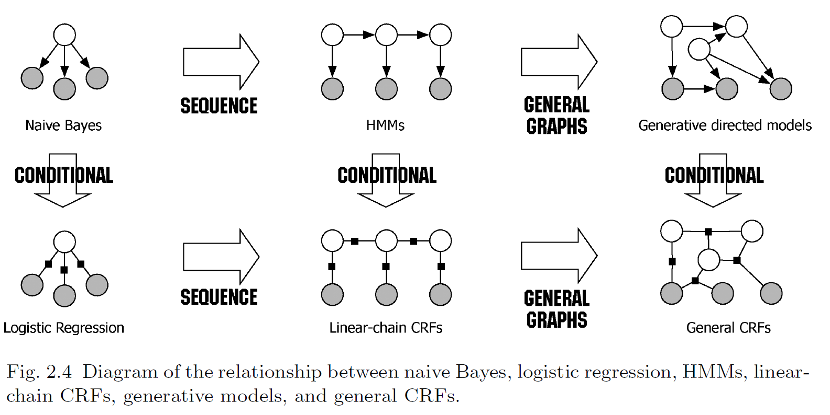
条件随机场 Conditional Random Fields(CRF)

Slide 6
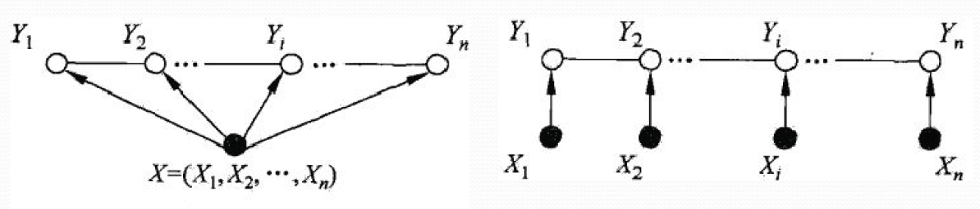
线性链CRFs
线性链条件随机场(linear chain conditional random field)
在条件概率模型P(Y|X)中，Y是输出变量，表示标记序列，X是输入变量，表示需要标注的观测序列，也把标记序列称为状态序列。
$$P\left(Y_{i} | X,Y_{1},Y_{2},…,Y_{N}\right)=P\left(Y_{i} | X,Y_{i−1},Y_{i+1}\right)$$

Slide 7



线性链CRFs
概率模型，在随机变量X取值为x的条件下，随机变量Y取值为y的条件概率具有如下形式
其中，
$f_{k}$定义在边上的特征函数，转移特征，依赖于前一个和当前位置
$s_{l}$定义在结点上的特征函数，状态特征，依赖于当前位置
$$P\left(y | x\right)=\frac{1}{Z(x)}exp⁡(\sum_{i,k}{λ_{k}f_{k}(y_{i−1},y_{i},x,i)}+\sum_{i,l}{μ_{k}s_{l}(y_{i},x,i)})$$
$$Z\left(x\right)=\sum_{y}{exp⁡(\sum_{i,k}{λ_{k}f_{k}(y_{i−1},y_{i},x,i)}+\sum_{i,l}{μ_{k}s_{l}(y_{i},x,i)})}$$
所有可能的序列

Slide 8


CRF的学习和推理
学习算法
改进的迭代尺度法、梯度下降法、拟牛顿法
极大化训练数据的极大似然
推理算法
维特比算法，只要计算非归一化的概率即可
位置1的各个标记$j=1,2..m$的非规范化概率
递归计算
直到$i=n$时终止，这时求得非规范化概率的最大值（记住路径，进行回溯，类似于HMM）
$$P\left(y | x\right)=\frac{1}{Z(x)}exp⁡(\sum_{i,k}{λ_{k}f_{k}(y_{i−1},y_{i},x,i)}+\sum_{i,l}{μ_{k}s_{l}(y_{i},x,i)})$$
$$δ_{i}\left(j\right)=w∙F_{i}\left(y_{0}=start,y_{1}=j,x\right),j=1,2,…,m$$
$$δ_{i}\left(l\right)=\max_{1≪f≪m}{\{δ_{i−1}\left(j\right)+w∙F_{i}\left(y_{i−1}=j,y_{i}=l,x\right)\}},j=1,2,…,m$$

Slide 9
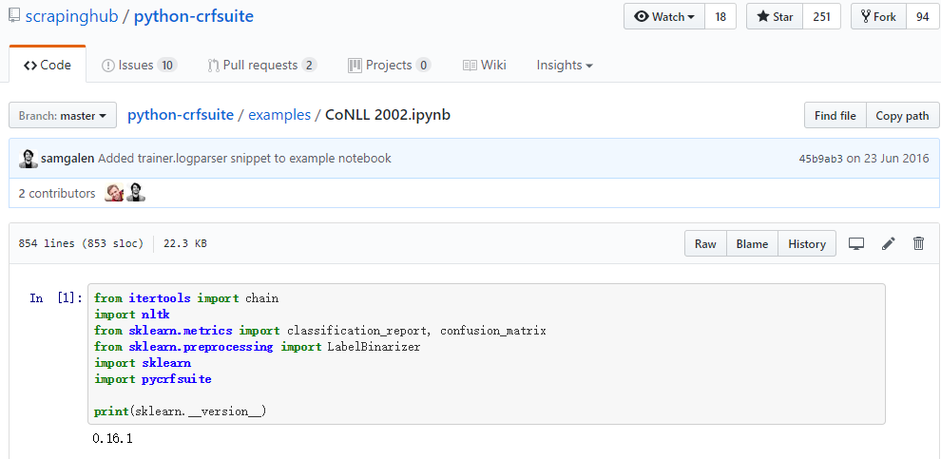
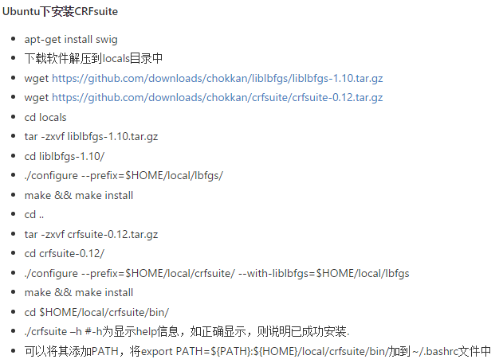
CRF使用指导
参考项目：python-crfsuite
https://github.com/scrapinghub/python-crfsuite
安装： pip install python-crfsuite
安装原版CRFsuite

Slide 10
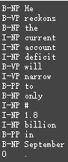
CRF进行NP Chunking
任务：https://www.clips.uantwerpen.be/conll2000/chunking/
数据集
wget http://www.clips.uantwerpen.be/conll2000/chunking/train.txt.gz
wget http://www.clips.uantwerpen.be/conll2000/chunking/test.txt.gz
He reckons the current account deficit will narrow to only # 1.8 billion in September.

Slide 11
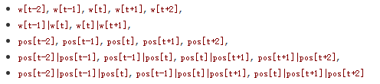
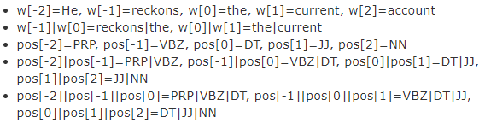
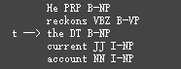
CRF实践：特征设计

Slide 12
完整示例程序及其讲解
jupyter notebook
~/codes/day3/CoNLL2000.ipynb

Slide 13
其他实践问题
如何加入数值特征，比如，词向量
continuous CRFs （但是，大部分现有工具都不支持）
对数值向量进行聚类
Semantic Hashing
主题建模（选取TOP-k个主题）
https://www.researchgate.net/post/How_can_I_incorporate_word_embedding_also_as_feature_in_CRF_based_sequence_labeling_task_in_text
https://www.reddit.com/r/MachineLearning/comments/340y86/is_it_possible_to_incorporate_word_embedding/

Slide 14
深度学习实践

Slide 15
目录 Content
序列标注模型 （30分钟）
CRF, CRF工具
TensorFlow介绍 （90分钟）
TensorFlow实践 （30分钟）
Logistics Regression
TensorFlow实践 （30分钟）
多层前馈网络

Slide 16


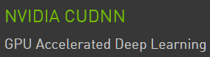




TensorFlow实践
什么是TensorFlow？
怎么用TensorFlow？
为什么选TensorFlow？

Slide 17
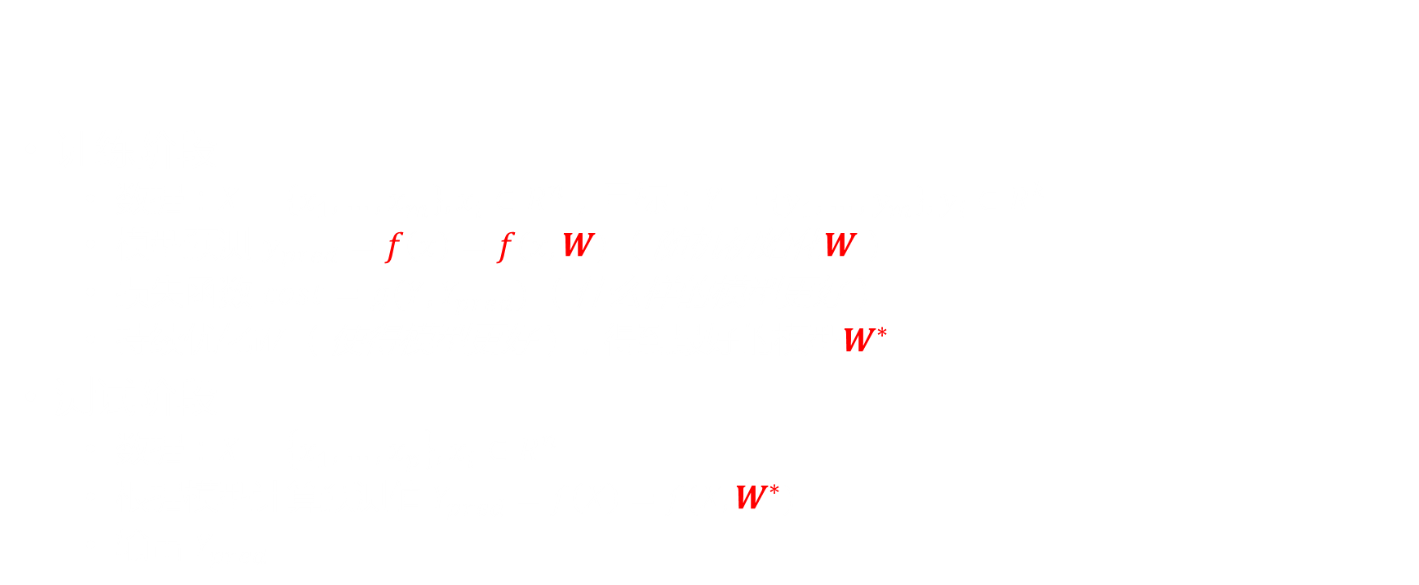
一个例子：自动分类
（人）选特征
训练阶段
数据：$X=\left\{x_{1},…,x_{m}\right\},x_{i}∈R^{n}$，目标：$Y=\left\{y_{1},…,y_{m}\right\},y_{i}∈R^{k}$
模型预测 $y_{pred}=f\left(x\right)=f(x,W)$ （随机初始化$W\text{）}$
损失函数 $cost=g(Y,Y_{pred})$ （什么样的模型更好）
持续优化$W$ （使得模型更好），得到最好$的模型W^{∗}$
测试阶段
数据：$X=\left\{x_{1},…,x_{p}\right\},x_{i}∈R^{n}$
根据模型计算预测值 $Y_{pred}=f\left(X\right)=f(X,W^{∗})$
输出 $Y_{pred}$
数据 X
特征 表示F
分类 Y
指导
（机器）学特征(权重)

Slide 18
自动分类的TensorFlow实践
import tensorflow as tf
with tf.Graph().as_default(): x_data = tf.placeholder(tf.float32, [None, 784]) y_data = tf.placeholder(tf.float32, [None, 10]) W = tf.Variable(tf.truncated_normal([784,10], stddev=0.1), name="W") b = tf.Variable(tf.constant(0.1, shape=[10]), name="b") y_pred = tf.nn.softmax(tf.matmul(x_data, W) + b) cost = tf.reduce_mean(-tf.reduce_sum(y_data*tf.log(y_pred), reduction_indices=1)) optimizer = tf.train.GradientDescentOptimizer(0.001).minimize(cost)
saver = tf.train.Saver(tf.global_variables(), max_to_keep=10)
with tf.Session() as sess: sess.run(tf.initialize_all_variables()) for epoch in range(training_epochs): for i in range(total_batch): batch_xs, batch_ys = mnist.train.next_batch(batch_size) _, loss = sess.run([optimizer, cost], feed_dict={x_data: batch_xs, y_data: batch_ys}) print "cost=%.6f % avg_ loss correct_prediction = tf.equal(tf.argmax(y_pred, 1), tf.argmax(y_data, 1)) accuracy = tf.reduce_mean(tf.cast(correct_prediction, tf.float32)) print "Accuracy:", accuracy.eval({x_data:test.images, y_data: test.labels})
saver.save(session, model_dir)

Slide 19
TensorFlow实践原则
模型 定义
定义输入数据
定义模型参数
定义模型运算过程
定义损失函数
定义参数更新
模型 训练/测试
导入训练/测试数据
执行运算
训练：参数更新
测试：模型运算
保存模型结果
模型
参数

Slide 20
自动分类的TensorFlow实践
import tensorflow as tf
with tf.Graph().as_default():
x_data = tf.placeholder(tf.float32, [None, 784]) y_data = tf.placeholder(tf.float32, [None, 10])
W = tf.Variable(tf.truncated_normal([784,10], stddev=0.1), name="W") b = tf.Variable(tf.constant(0.1, shape=[10]), name="b")
y_pred = tf.nn.softmax(tf.matmul(x_data, W) + b)
cost = tf.reduce_mean(-tf.reduce_sum(y_data*tf.log(y_pred), reduction_indices=1))
optimizer = tf.train.GradientDescentOptimizer(0.001).minimize(cost)
saver = tf.train.Saver(tf.global_variables(), max_to_keep=10)
模型 定义
输入数据
模型参数
模型运算过程
损失函数
参数更新

Slide 21
自动分类的TensorFlow实践
with tf.Session() as sess: sess.run(tf.initialize_all_variables()) for epoch in range(training_epochs): for i in range(total_batch):
batch_xs, batch_ys = mnist.train.next_batch(batch_size)
_, loss = sess.run([optimizer, cost], feed_dict={x_data: batch_xs, y_data: batch_ys})
print "cost=%.6f % avg_ loss
correct_prediction = tf.equal(tf.argmax(y_pred, 1), tf.argmax(y_data, 1)) accuracy = tf.reduce_mean(tf.cast(correct_prediction, tf.float32)) print "Accuracy:", accuracy.eval({x_data:test.images, y_data: test.labels})
saver.save(session, model_dir)
模型 训练/测试
训练数据
参数更新
模型测试
保存模型结果

Slide 22
TensorFlow
TensorFlow™ 是一个采用数据流图（data flow graphs），用于数值计算的开源软件库。
TensorFlow 最初由Google大脑小组（隶属于Google机器智能研究机构）的研究员和工程师们开发出来，用于机器学习和深度神经网络方面的研究，但这个系统的通用性使其也可广泛用于其他计算领域。
To us
TensorFlow提供了对Tensors的基本操作算子， 并能自动对他们求导。
Notes:
TensorFlow™ 是一个采用数据流图（data flow graphs），用于数值计算的开源软件库。节点（Nodes）在图中表示数学操作，图中的线（edges）则表示在节点间相互联系的多维数据数组，即张量（tensor）。它灵活的架构让你可以在多种平台上展开计算，例如台式计算机中的一个或多个CPU（或GPU），服务器，移动设备等等。TensorFlow 最初由Google大脑小组（隶属于Google机器智能研究机构）的研究员和工程师们开发出来，用于机器学习和深度神经网络方面的研究，但这个系统的通用性使其也可广泛用于其他计算领域。

Slide 23
Models with TF
autoencoder -- various autoencoders
inception -- deep convolutional networks for computer vision
namignizer -- recognize and generate names
neural_gpu -- highly parallel neural computer
privacy -- privacy-preserving student models from multiple teachers
resnet -- deep and wide residual networks
slim -- image classification models in TF-Slim
swivel -- the Swivel algorithm for generating word embeddings
syntaxnet -- neural models of natural language syntax
textsum -- sequence-to-sequence with attention model for text summarization.
transformer -- spatial transformer network, which allows the spatial manipulation of data within the network
im2txt -- image-to-text neural network for image captioning.
neural_programmer -- neural network augmented with logic and mathematic operations.
https://github.com/tensorflow/models

Slide 24
TensorFlow Uses
RankBrain
Organization: Google
Domain: Information Retrieval
Description: A large-scale deployment of deep neural nets for search ranking on www.google.com.
More info: "Google Turning Over Its Lucrative Search to AI Machines"
Inception Image Classification Model
Organization: Google
Description: Baseline model and follow on research into highly accurate computer vision models, starting with the model that won the 2014 Imagenet image classification challenge
More Info: Baseline model described in Arxiv paper
SmartReply
Organization: Google
Description: Deep LSTM model to automatically generate email responses
More Info: Google research blog post
Massively Multitask Networks for Drug Discovery
Organization: Google and Stanford University
Domain: Drug discovery
Description: A deep neural network model for identifying promising drug candidates.
More info: Arxiv paper
On-Device Computer Vision for OCR
Organization: Google
Description: On-device computer vision model to do optical character recognition to enable real-time translation.
More info: Google Research blog post
Neural Machine Translation
…
https://www.tensorflow.org/versions/r0.12/resources/uses.html

Slide 25
为什么学习/使用TensorFlow
免去求导的过程
使用GPU大幅度加速
更好地训练神经网络模型
和Python、NumPy紧密结合，容易上手，教程易懂
对于中小项目，很好的深度学习工具
…
快速解决问题
易于使用，资源丰富，文档齐全，社群活跃
Google出品，必属精品
发展势头猛
开源项目越来越多
…

Slide 26
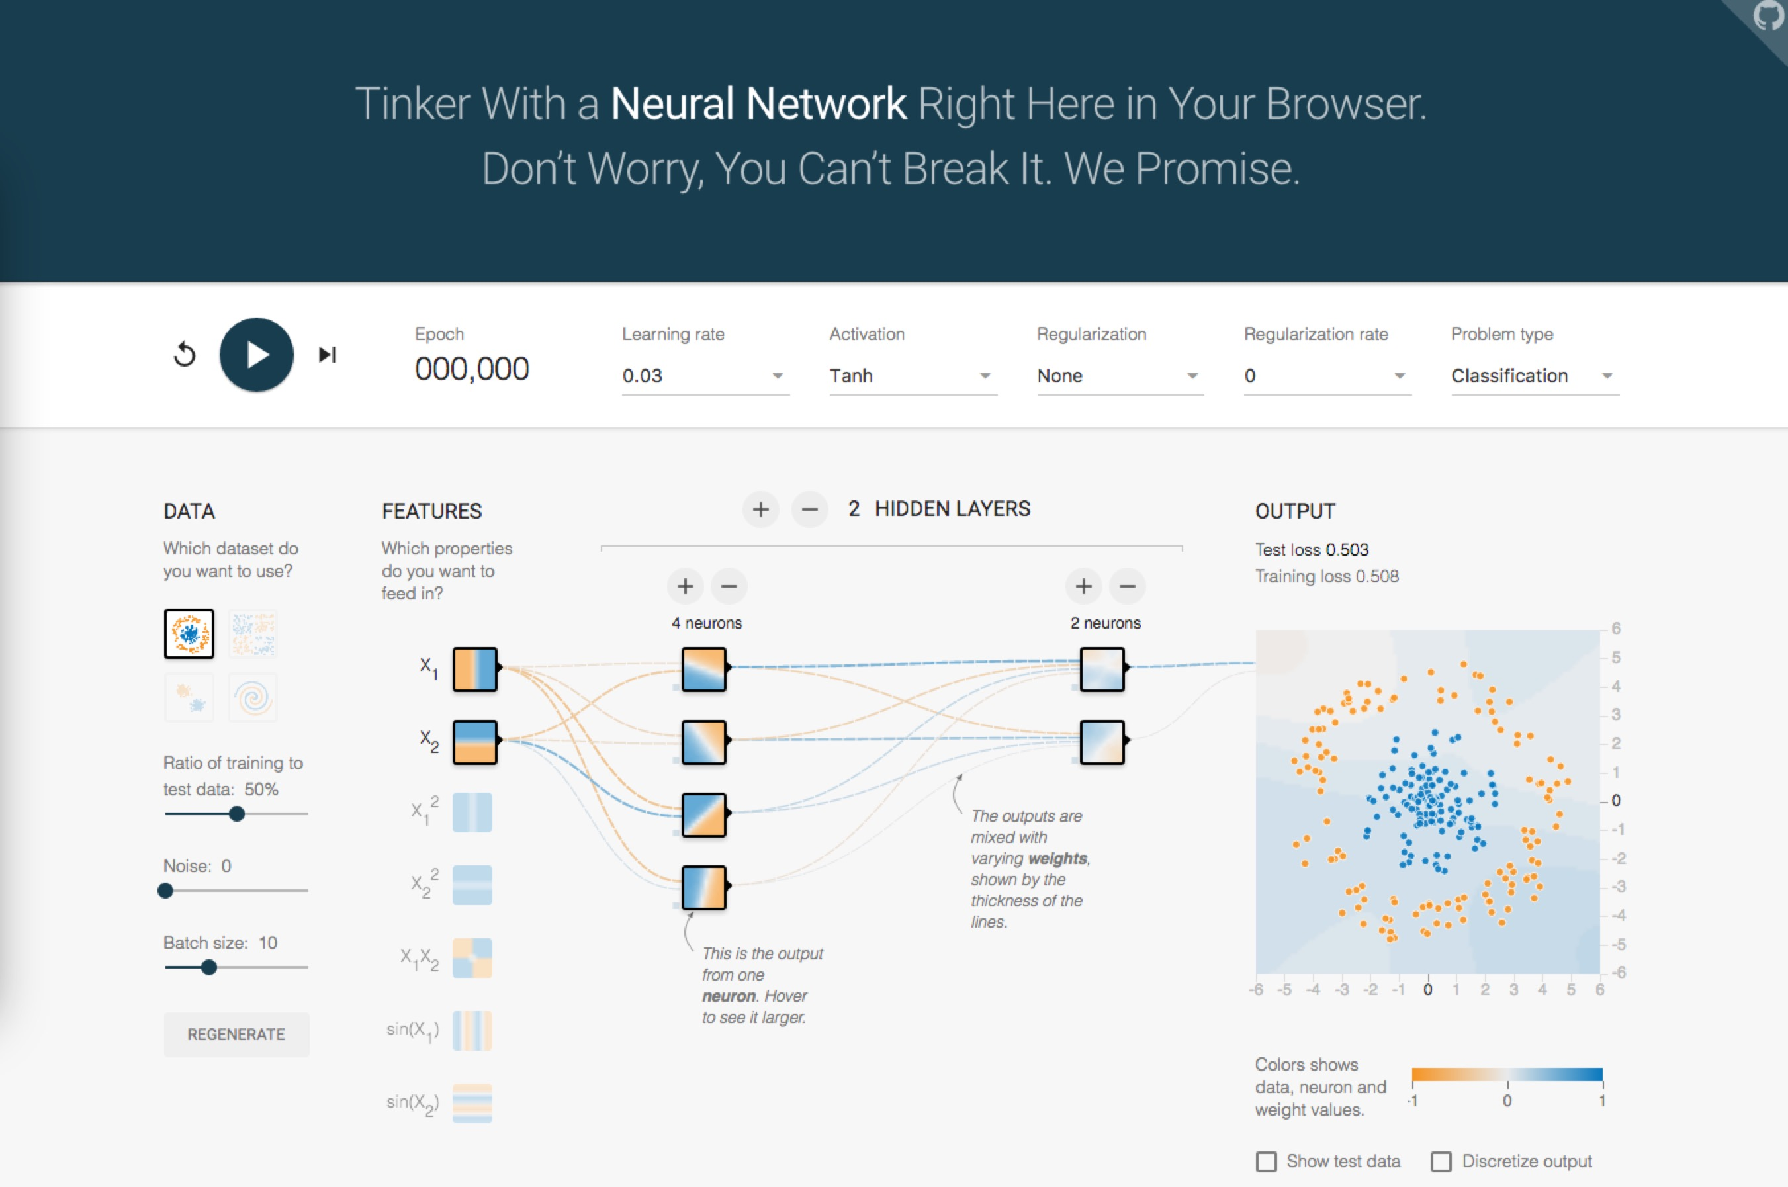
http://playground.tensorflow.org/

Slide 27
TensorFlow vs. Numpy
TensorFlow编程中大量利用NumPy
Numpy中全部是常量，TensorFlow中可以定义占位符、变量等多种类型的数据
TensorFlow可以定义自动求导公式，而NumPy中只能定义具体的函数

Slide 28
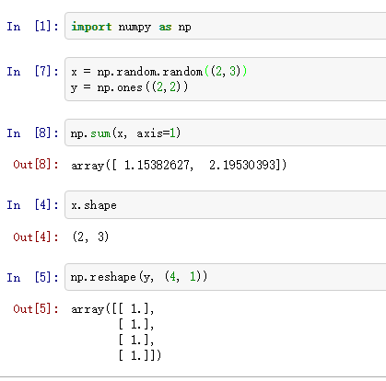
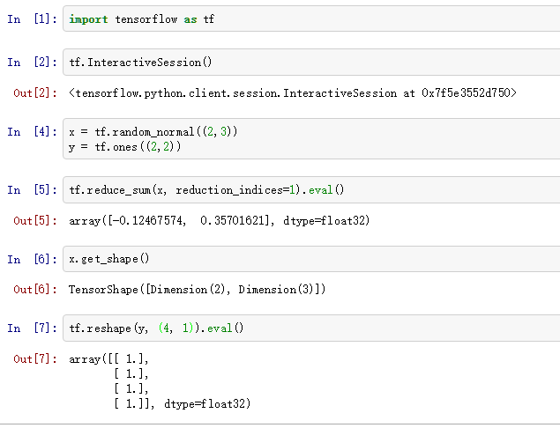
TensorFlow vs. Numpy
NumPy
TensorFlow

Slide 29
TensorFlow 重要概念
Tensor
Graph
Session
Device
Variable
Constant
Placeholder
Auto-Differentiation
Optimizer
TensorBoard
https://www.tensorflow.org/versions/r0.12/resources/glossary.html

Slide 30
Tensors
张量是一种表示物理量的方式，这个方式就是用基向量与分量组合表示物理量 (Combination of basis vector and component).
标量，0个基向量：0-mode tensor
向量，1个基向量：1-mode tensor
矩阵，2个基向量：2-mode tensor
…
张量可以表示为多维数组 (a tensor can be represented as a multidimensional array of numbers)
https://www.tensorflow.org/versions/r0.12/resources/dims_types.html

Slide 31
Graph
A TensorFlow computation, represented as a dataflow graph.
A Graph contains a set of Operation objects, which represent units of computation; and Tensor objects, which represent the units of data that flow between operations.
A tf.Graph is a collection of ops that may be executed together as a group. Most TensorFlow uses will only need to rely on the single default graph.

Slide 32
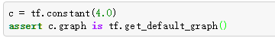
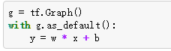
Graph
A default Graph is always registered, and accessible by calling tf.get_default_graph().
Another typical usage involves the Graph.as_default() context manager, which overrides the current default graph for the lifetime of the context:

Slide 33
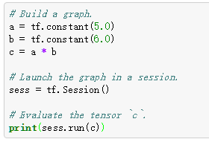
Session
A class for running TensorFlow operations.
A Session object encapsulates the environment in which Operation objects are executed, and Tensor objects are evaluated.

Slide 34
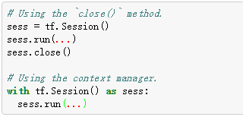
Session
A session may own resources, such as variables, queues, and readers. It is important to release these resources when they are no longer required. To do this, either invoke the close() method on the session, or use the session as a context manager.
The following two examples are equivalent:

Slide 35
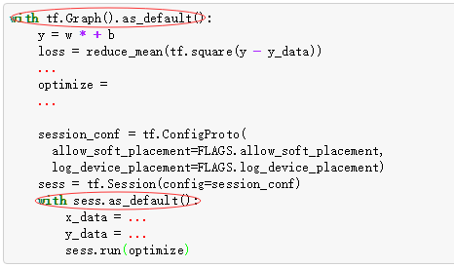
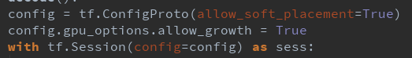
Graph & Session
The ConfigProto protocol buffer exposes various configuration options for a session.

Slide 36
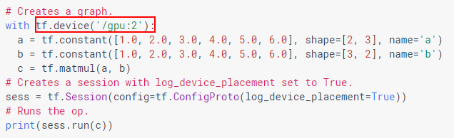
Device
On a typical system, there are multiple computing devices.
In TensorFlow, the supported device types are CPU and GPU. They are represented as strings.
For examples
"/cpu:0": The CPU of your machine.
"/gpu:0": The GPU of your machine, if you have one.
"/gpu:1": The second GPU of your machine, etc.

Slide 37
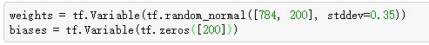
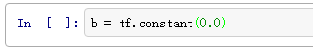
Variables
Variables are used to hold and update parameters. Variables are in-memory buffers containing tensors.
They must be explicitly initialized and can be saved to disk during and after training.
All tensors we’ve used previously have been constant tensors, not variables.

Slide 38
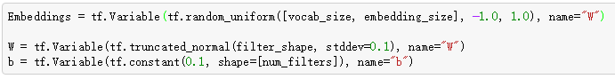
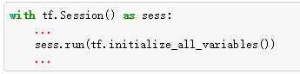
Variables
TensorFlow variables must be initialized before they have values!

Slide 39
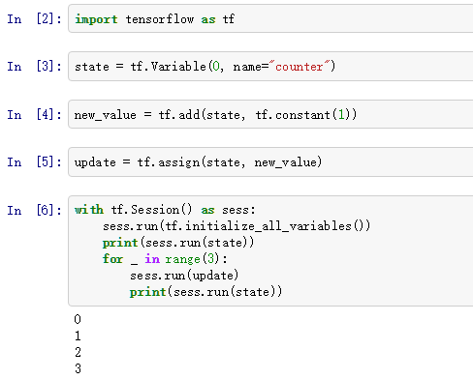
Updating Variable State
new_value = state + 1
state = new_value
state = 0 print(state) for _ in range(3): state = state + 1 print(state)

Slide 40
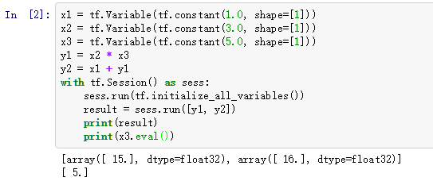
Fetching Variable State
Calling sess.run(var) on a tf.Session() object retrieves its value.
Can retrieve multiple variables simultaneously with
sess.run([var1, var2])

Slide 41
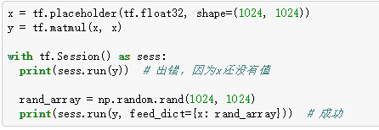
Placeholders and Feed Dictionaries
Use tf.placeholder variables (dummy nodes that provide entry points for data to computational graph).
A feed_dict is a python dictionary mapping from tf.placeholder vars (or their names) to data (numpy arrays, lists, etc.).
Mini-batch SGD

Slide 42
Variable Scope
Complicated TensorFlow models can have hundreds of variables.
tf.variable_scope() provides simple name-spacing to avoid clashes.
tf.get_variable() creates/accesses variables from within a variable scope.
Variable scope is a simple type of namespacing that adds prefixes to variable names within scope
with tf.variable_scope("foo"): with tf.variable_scope("bar"): v = tf.get_variable("v", [1])
v.name == "foo/bar/v:0"

Slide 43
Variable Scope
Variable scopes control variable (re)use
with tf.variable_scope("foo"): v = tf.get_variable("v", [1]) tf.get_variable_scope().reuse_variables() v1 = tf.get_variable("v", [1])
v1 == v
with tf.variable_scope("foo"): v = tf.get_variable("v", [1]) # v.name == "foo/v:0" w = tf.get_variable("w", [1]) # w.name == "foo/w:0" with tf.variable_scope("foo", reuse=True) v1 = tf.get_variable("v") # The same as v above.
implement RNNs ！！！

Slide 44
Auto-Differentiation
How can we learn parameters and fit model to data?
tf.train.Optimizer creates an optimizer.
tf.train.Optimizer.minimize(loss, var_list) adds optimization operation to computation graph.
Automatic differentiation computes gradients without user input!
optimizer = tf.train.AdamOptimizer(0.001)
grads_and_vars = optimizer.compute_gradients(loss)
train_op = optimizer.apply_gradients(grads_and_vars)
capped_grads_and_vars = [(MyCapper(gv[0]), gv[1]) for gv in grads_and_vars]

Slide 45
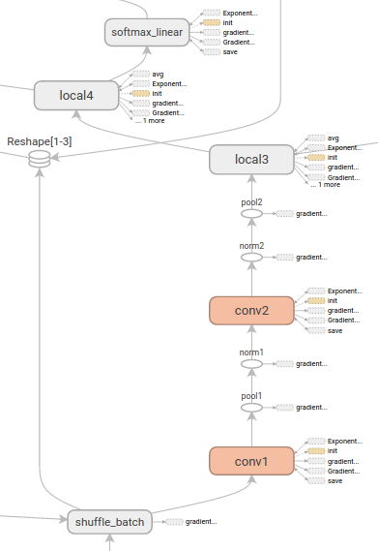
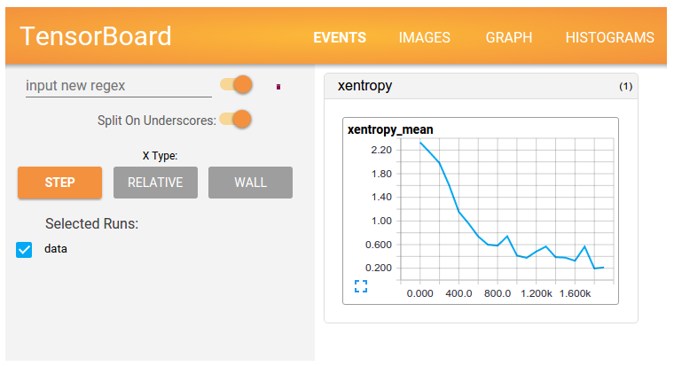
TensorBoard
Graph Visualization
The graph visualization can help you understand and debug them.
Visualizing Log Data
Plot quantitative metrics about the execution of your graph
Show additional data like images that pass through it.

Slide 46
一个例子串起来：线性回归
xs = np.linspace(-3, 3, 100) ys = np.sin(xs) + np.random.uniform(-0.5, 0.5, 100) graph = tf.Graph() with graph.as_default(): input_X = tf.placeholder(tf.float32, name="input_X") input_Y = tf.placeholder(tf.float32, name="input_Y") W = tf.Variable(tf.random_normal([1]), name='weight') b = tf.Variable(tf.random_normal([1]), name='bias') Y_pred = tf.add(tf.multiply(input_X, W, name="mul"), b, name="add") cost = tf.reduce_sum(tf.pow(Y_pred - input_Y, 2)) / (100 - 1) tf.summary.scalar('cost', cost) learning_rate = 0.01 optimizer = tf.train.GradientDescentOptimizer(learning_rate).minimize(cost) merged = tf.summary.merge_all() n_epochs = 50 with tf.Session(graph=graph) as sess: train_writer = tf.summary.FileWriter('linear/train', sess.graph) sess.run(tf.global_variables_initializer()) prev_training_cost = 0.0 for epoch_i in range(n_epochs): for (x, y) in zip(xs, ys): sess.run(optimizer, feed_dict={input_X: x, input_Y: y}) summary, training_cost = sess.run([merged, cost], feed_dict={input_X: xs, input_Y: ys}) train_writer.add_summary(summary, epoch_i) print(training_cost) if np.abs(prev_training_cost - training_cost) < 0.000001: break prev_training_cost = training_cost

Slide 47
演示
IPython演示
ipython notebook (jupyter notebook)
TensorBoard展示
tensorboard --logdir=linear/train
127.0.0.1:6006/

Slide 48
目录 Content
序列标注模型 （30分钟）
CRF, CRF工具
TensorFlow介绍 （90分钟）
TensorFlow实践 （30分钟）
Logistics Regression
TensorFlow实践 （30分钟）
多层前馈网络

Slide 49
经典例子：mnist分类
MNIST的历史 - 1998年至今
6万个训练样本，1万个测试样本
贡献者：Yann LeCun等人
意义
链接： http://yann.lecun.com/exdb/mnist/
演化：MNIST – CIFAR – ImageNet

Slide 50
Implements logistic regression in 10 minutes
import tensorflow as tf #使用标准MINST数据 from tensorflow.examples.tutorials.mnist import input_data mnist = input_data.read_data_sets("/tmp/data/", one_hot=True) #参数 learning_rate = 0.01 training_epochs = 20 batch_size = 120 with tf.Graph().as_default(): # 输入数据 x_data = tf.placeholder(tf.float32, [None, 784]) y_data = tf.placeholder(tf.float32, [None, 10]) # 模型参数 W = tf.Variable(tf.truncated_normal([784,10], stddev=0.1), name="W") b = tf.Variable(tf.constant(0.1, shape=[10]), name="b") # 构造模型 y_pred = tf.nn.softmax(tf.matmul(x_data, W) + b) # 损失函数 cost = tf.reduce_mean(-tf.reduce_sum(y_data*tf.log(y_pred),
reduction_indices=1)) # 优化 optimizer = tf.train.GradientDescentOptimizer(learning_rate).minimize(cost)
with tf.Session() as sess: init = tf.initialize_all_variables() sess.run(init) # 开始执行程序，每次选择batch的样本 for epoch in range(training_epochs): avg_cost = 0.0 total_batch = int(mnist.train.num_examples/batch_size) for i in range(total_batch): batch_xs, batch_ys = mnist.train.next_batch(batch_size) _, c = sess.run([optimizer, cost], feed_dict={x_data: batch_xs, y_data: batch_ys}) avg_cost += c / total_batch if (epoch + 1) % 10 == 0: print "Epoch:", '%04d' % (epoch+1), "cost=", "{:.9f}".format(avg_cost) # 模型测试 correct_prediction = tf.equal(tf.argmax(y_pred, 1), tf.argmax(y_data, 1)) accuracy = tf.reduce_mean(tf.cast(correct_prediction, tf.float32)) print "Accuracy:", accuracy.eval( {x_data: mnist.test.images, y_data: mnist.test.labels})

Slide 51
演示
IPython演示
ipython notebook (jupyter notebook)
TensorBoard展示
tensorboard --logdir=mnist_logs/train
127.0.0.1:6006/

Slide 52
程序总结
Graph 定义
定义输入数据
定义模型参数
定义模型运算过程
定义损失函数
定义参数更新
Session 运行
模型训练
导入训练数据
选取一个batch数据加入feed词典中
执行程序：session.run(update)
保存程序结果
模型测试
导入训练模型（训练保存的结果）
导入测试数据
选取一个batch数据加入feed词典中
执行程序：session.run(predictions)
计算预测效果

Slide 53
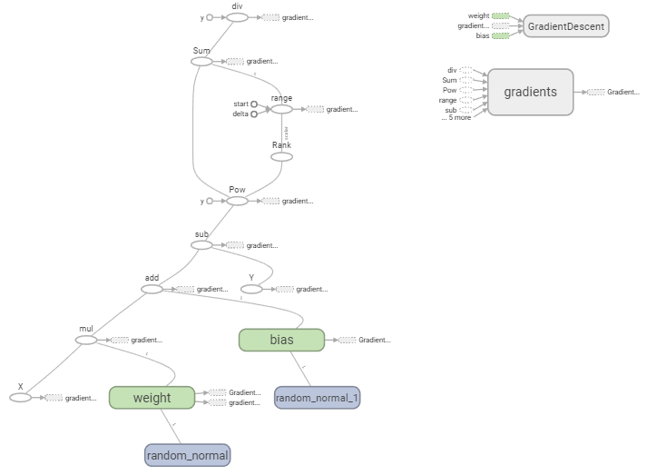
TensorFlow = Tensor + Flow
Computation = Flows of tensors

Slide 54
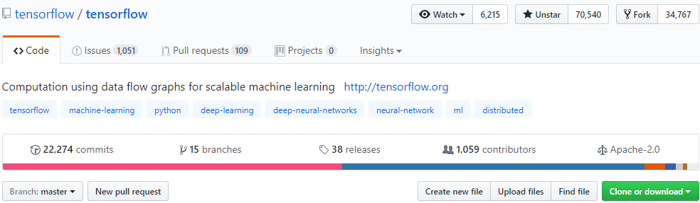
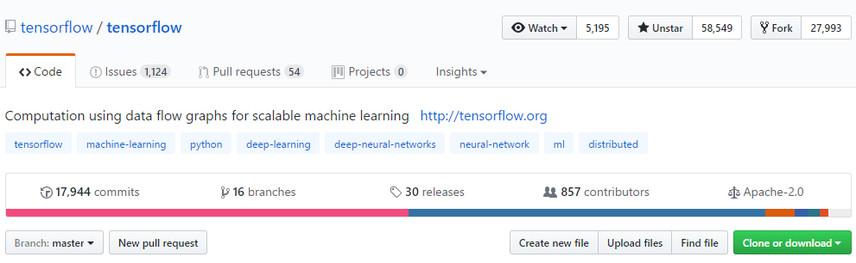
TensorFlow版本说明
TF发展非常迅猛，发布于2015年11月的开源项目，短短2年，已经是github上最受关注的项目，目前最近版本为1.3版本
1.0版本API修改非常多（名称和参数）
版本之间的移植
python tf_upgrade.py --infile InputFile --outfile OutputFile
python tf_upgrade.py --intree InputDir --outtree OutputDir
参考：https://www.tensorflow.org/install/migration

Slide 55
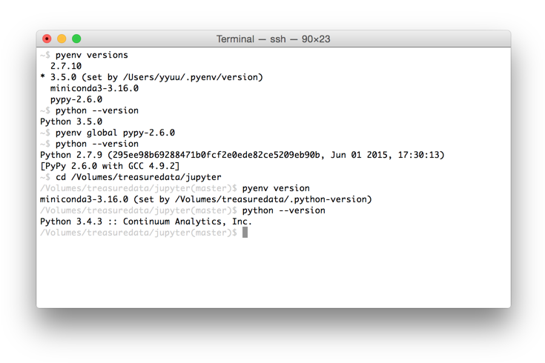
番外篇：如何解决版本差异
不同版本需要不同版本的CUDA
不同用户需要不同版本
一台服务器需要不同版本
Python3.5 vs. Python2.7
一台服务器包含多个Python环境
每个用户包含多个Python环境
每个Python环境包含一个TF版本
使用pyenv 管理多個Python 版本
https://github.com/pyenv/pyenv

Slide 56
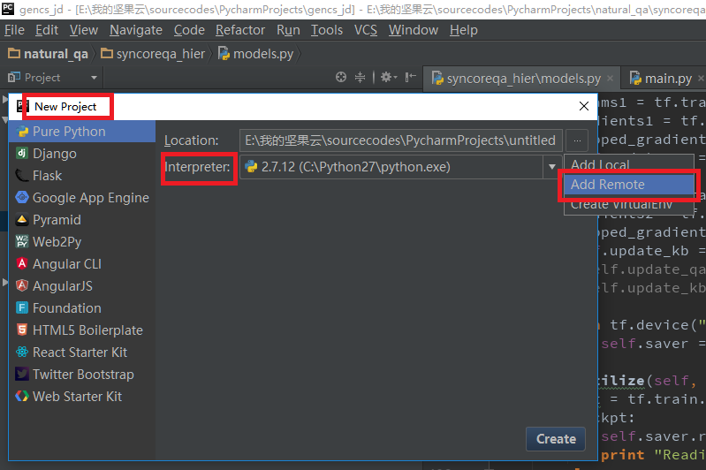
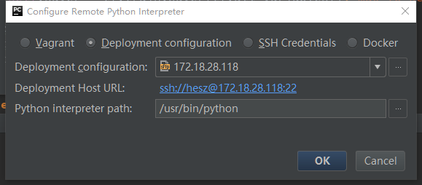
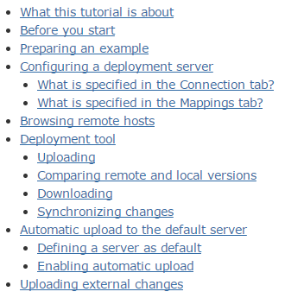
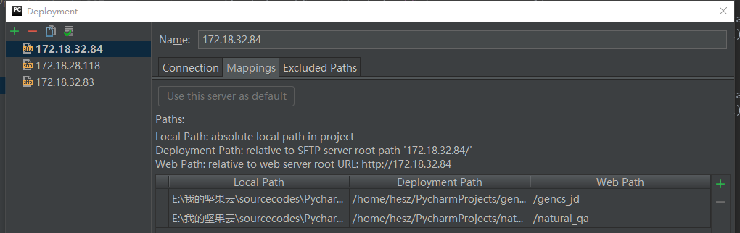
番外篇：如何本机IED编程使用远程服务器解释器
Deployment in PyCharm
https://confluence.jetbrains.com/display/PYH/Deployment+in+PyCharm

Slide 57
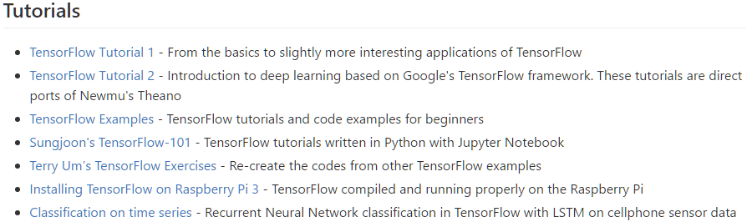
TensorFlow 资料
https://github.com/aymericdamien/TensorFlow-Examples
https://indico.io/blog/the-good-bad-ugly-of-tensorflow/
http://www.wildml.com/2016/08/rnns-in-tensorflow-a-practical-guide-and-undocumented-features/
https://github.com/jtoy/awesome-tensorflow
http://www.wildml.com/

Slide 58
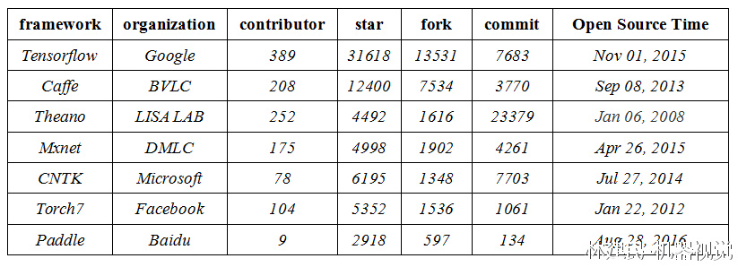
目前流行的深度学习框架在Github上的比较
Tensorflow：https://github.com/tensorflow/tensorflow 使用的组织和公司：Google、DeepMind、OpenAI ...
Caffe：https://github.com/BVLC/caffe 使用的组织和公司：BLVC等等
Theano：https://github.com/Theano/Theano：使用的组织和公司：Lisa Lab 等等
Mxnet：https://github.com/dmlc/mxnet 使用的组织和公司：亚马逊等。
CNTK：https://github.com/Microsoft/CNTK 使用的组织和公司：Microsoft
Torch7：https://github.com/torch/torch7 使用的组织和公司：Facebook
PyTorch： https://github.com/pytorch/pytorch
Paddle：https://github.com/baidu/Paddle 使用的组织和公司：Baidu

Slide 59
更多的选择：Keras
Keras：基于Theano或者Tensorflow的高度封装
优点：对于简单用户、简单需求，非常合适
缺点：对于复杂的需求很难胜任；文档简单
Too simple, sometime naïve.

Slide 60
Deep-Learning Package Choices
编写配置文件 (Caffe, CNTK) vs. 编写执行程序 (Theano, Tensorflow)
搭积木 (Torch) vs. 计算过程 (Theano, Tensorflow)
编程模式 (求导方式)：符号推导 (Theano, Tensorflow) vs. 反向梯度传播 (Torch)
支撑语言：Lua (Torch) vs. Python (Theano, Tensorflow)
效率问题：GPU，分布式平台等
…
Python & Google

Slide 61
TensorFlow学习
文档中也有很多例子
对于教程和教程指出的问题，要熟悉
动手实践
手握文档，多查多试
遇到问题，多Google
多看Github上其他人使用TensorFlow写的代码
Debug，Debug，Debug…

Slide 62
TensorFlow实践中的一些原则
Detail dilutes, Principle matters!
经验之谈，仅供参考！
编程前
确定模型，写清楚每一个矩阵、向量的大小，写清楚每一步运算前后的维度变化
编程时
模块化测试，用注释的方式明确每个component前后维度变化、数值变化
耐心debug
耐心debug
耐心debug
使用一些方法监测程序运行时的数值、结果
深度学习：一个关于shape的游戏。

Slide 63
目录 Content
序列标注模型 （30分钟）
CRF, CRF工具
TensorFlow介绍 （90分钟）
TensorFlow实践 （30分钟）
Logistics Regression
TensorFlow实践 （30分钟）
多层前馈网络

Slide 64
使用TensorFlow实现文本分类
向量空间模型（VSM）
文本：向量表示（tf-idf权重）
分类：TensorFlow实现

Slide 65
文本的向量表示
def create_vocbulary(self, max_vocab_size=30*1000): #先获取词表 word_counts = Counter() with codecs.open(self.data_path, 'rb', 'utf-8') as f: for line in f: label, text = line.split('\t', 1) words = tokenizer(text) word_counts.update(words) word_frqs = word_counts.most_common(max_vocab_size) self.vocab_list = [x[0] for x in word_frqs] self.vocab_size = len(self.vocab_list) self.vocab = dict([(x, y) for (y, x) in enumerate(self.vocab_list)]) print "vocab size: ", self.vocab_size
对全部语料统计词表（vocabulary）
对单个文本分词
对单个文本计算TF(IDF)
def tokenizer(sent): words = [w.strip() for w in nltk.word_tokenize(sent)] words = [w.lower() for w in words if len(w) > 0] return words
for line in f: label, text = line.split('\t', 1) x_data, y_data = list(), list() word_counts = Counter() word_counts.update(tokenizer(text)) for word in self.vocab_list: value = 1.0 if word in word_counts else 0.0 x_data.append(value) dataset.append((x_data, y_data))

Slide 66
Tensoflow进行文本分类：模型
with tf.Graph().as_default(): x_data = tf.placeholder(tf.float32, [None, m]) y_data = tf.placeholder(tf.float32, [None, 2]) W = tf.Variable(tf.truncated_normal([m, 2], stddev=0.1), name="W") b = tf.Variable(tf.constant(0.1, shape=[2]), name="b") y_pred = tf.nn.softmax(tf.matmul(x_data, W) + b) cost = tf.reduce_mean(-tf.reduce_sum(y_data * tf.log(y_pred), reduction_indices=1)) loss = cost + 0.025 * (tf.nn.l2_loss(W) + tf.nn.l2_loss(b)) optimizer = tf.train.GradientDescentOptimizer(0.001).minimize(loss)

Slide 67
Tensoflow进行文本分类：训练和测试
with tf.Session() as session: session.run(tf.global_variables_initializer()) for epoch in xrange(1, 100): epoch_start = time.time() loss_sum = 0.0 for start, end in zip(range(0, len(train_X), 128), range(128, len(train_X) + 1, 128)): _, curr_loss = session.run([optimizer, loss], feed_dict={x_data: train_X[start:end], y_data: train_Y[start:end]}) loss_sum += curr_loss epoch_finish = time.time() print "第 %d 轮 loss %.5f time %.2f" % (epoch, loss_sum, epoch_finish - epoch_start) # 模型测试 correct_prediction = tf.equal(tf.argmax(y_pred, 1), tf.argmax(y_data, 1)) accuracy = tf.reduce_mean(tf.cast(correct_prediction, tf.float32)) print "第", epoch, "轮学习, 准确率为: ", accuracy.eval({x_data: test_X, y_data: test_Y})

Slide 68
Deep Learning

Slide 69

Multilayer Perceptron 多层感知机
$$f\left(x\right)=f_{2}(b^{2}+W^{2}∙(f_{1}(b^{1}+W^{1}∙x)))$$
激活函数：$f_{1}$，$f_{2}$
权重和偏置：$W^{1}，b^{1}$，$W^{2}$，$b^{2}$
输入：$x$
输出：$f(x)$

Slide 70
MLP示例代码
# 创建模型
def multilayer_perceptron(x, weights, biases):
# 第一层，使用RELU作为激活函数
layer_1 = tf.add(tf.matmul(x, weights['h1']), biases['b1'])
layer_1 = tf.nn.relu(layer_1)
# 第二层，也用RELU作为激活函数
layer_2 = tf.add(tf.matmul(layer_1, weights['h2']), biases['b2'])
layer_2 = tf.nn.relu(layer_2)
# 输出映射
out_layer = tf.matmul(layer_2, weights['out']) + biases['out']
return out_layer

Slide 71
NumPy实现前馈部分
# forward-pass of a 3-layer neural network:
f = lambda x: 1.0/(1.0 + np.exp(-x)) # activation function (use sigmoid)
x = np.random.randn(64, 784) # random input vector of three numbers (3x1)
h1 = f(np.dot(W1, x) + b1) # calculate first hidden layer activations (4x1)
h2 = f(np.dot(W2, h1) + b2) # calculate second hidden layer activations (4x1)
out = np.dot(W3, h2) + b3 # output neuron (1x1)

Slide 72
NumPy实现反向传播部分
跳过！
曾经的噩梦，现在对于大多数人来说，已经不需要考虑了。
对于研究者而言，在学习时推导、实现仍旧是必须的。
如果你想实现：
CS231n
CS224d
UFLDL

Slide 73
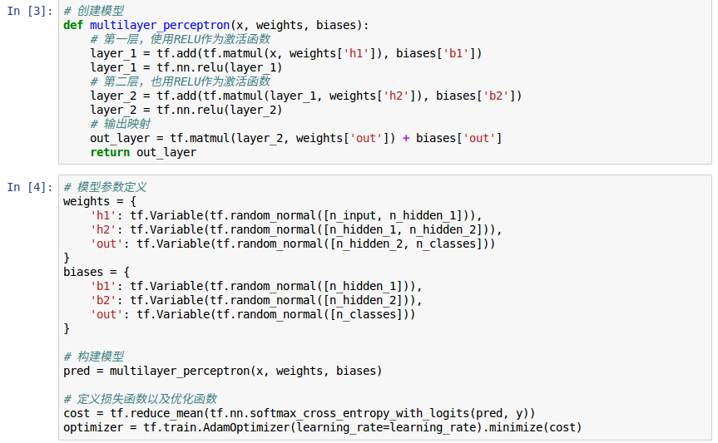
使用多层感知机进行手写体识别：讲解
代码参考：multilayer_perceptron.ipynb
核心部分：模型定义（Graph）

Slide 74
总结
序列标注
CRF工具介绍
深度学习工具
TensorFlow介绍
深度学习实践
Logistics Regression
多层前馈网络

Slide 75
谢谢！ QA!

